Slide 1
Shell Bootcamp 2024 3 Reflections for Week 3
Kabir Dhruw
Date : 13-Sept-2024

Slide 2

About Me
Chase excellence, Not perfection.

Slide 3

My learnings from this week!

Slide 4
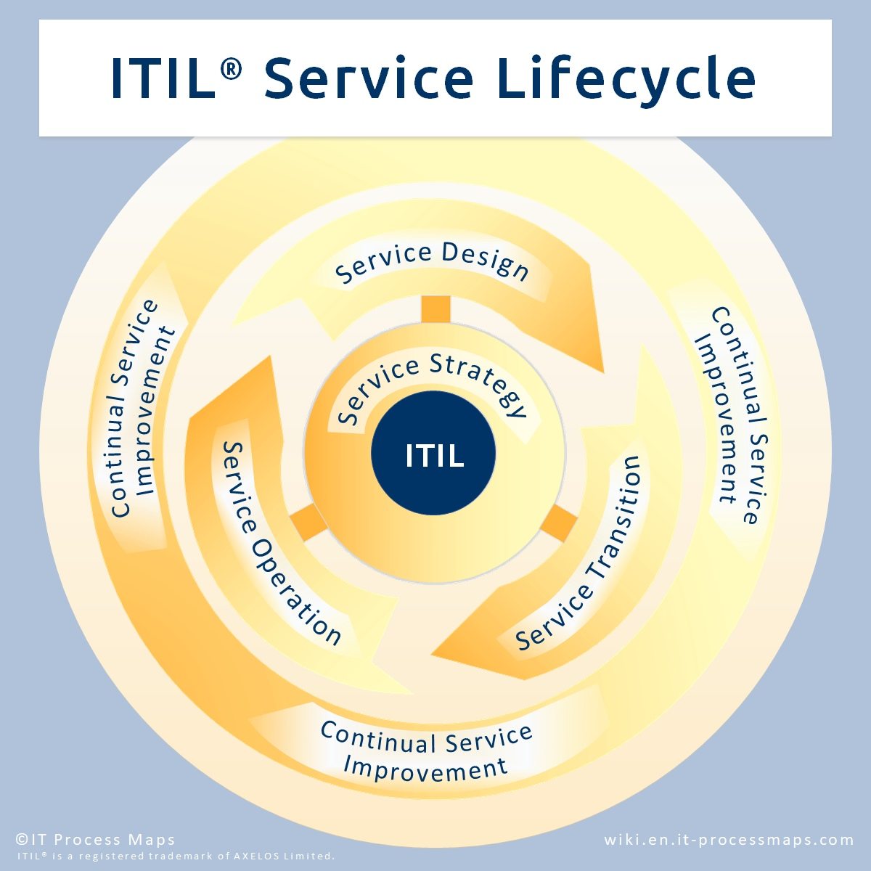
Learning 1 |
ITIL helps align IT services with business goals, ensuring that IT supports the overall strategy and operations of the organization. It provides a structured approach to managing IT services efficiently.
ServiceNow automates and streamlines IT service management processes, making it easier to manage incidents, changes, and service requests. This leads to improved service quality and higher user satisfaction.
Both ITIL and ServiceNow emphasize the need for ongoing assessment and refinement of IT processes.

Slide 5
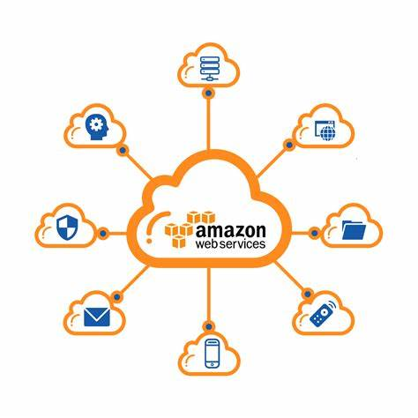
Learning 2 |
AWS EC2 provides scalable virtual servers, enabling flexible compute capacity for running applications.
AWS S3 offers secure, scalable object storage for data backup, archiving, and analytics.
AWS VPC allows the creation of isolated virtual networks, giving control over network configuration and security.

Slide 6
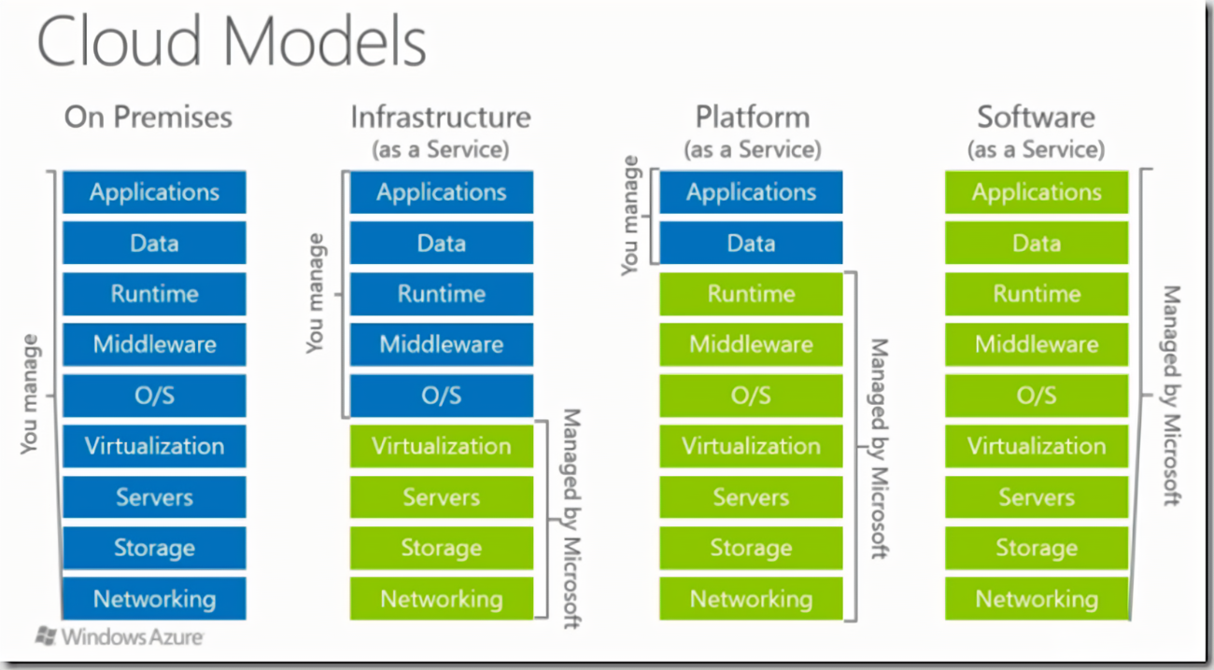
Learning 3 |
Azure Virtual Machines provide scalable compute capacity, Azure Virtual Network ensures control over network configuration and security, and Azure Storage offers secure, scalable solutions for data backup and analytics.
Together, these services enhance an organization’s scalability, reliability, and security in the cloud.

Slide 7

Relevance of learnings for my organization

Slide 8
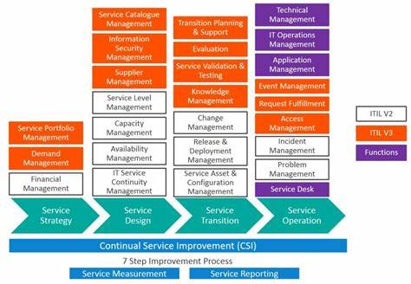
Learning 1 | Relevance for Shell
By aligning IT services with business objectives, ITIL ensures that IT supports the overall strategy and operations. This leads to more efficient service delivery, better resource management, and improved customer satisfaction.
ServiceNow automates IT service management processes, reducing manual effort and errors. This results in faster resolution of incidents, streamlined workflows, and enhanced service quality, which ultimately boosts productivity and user satisfaction.

Slide 9
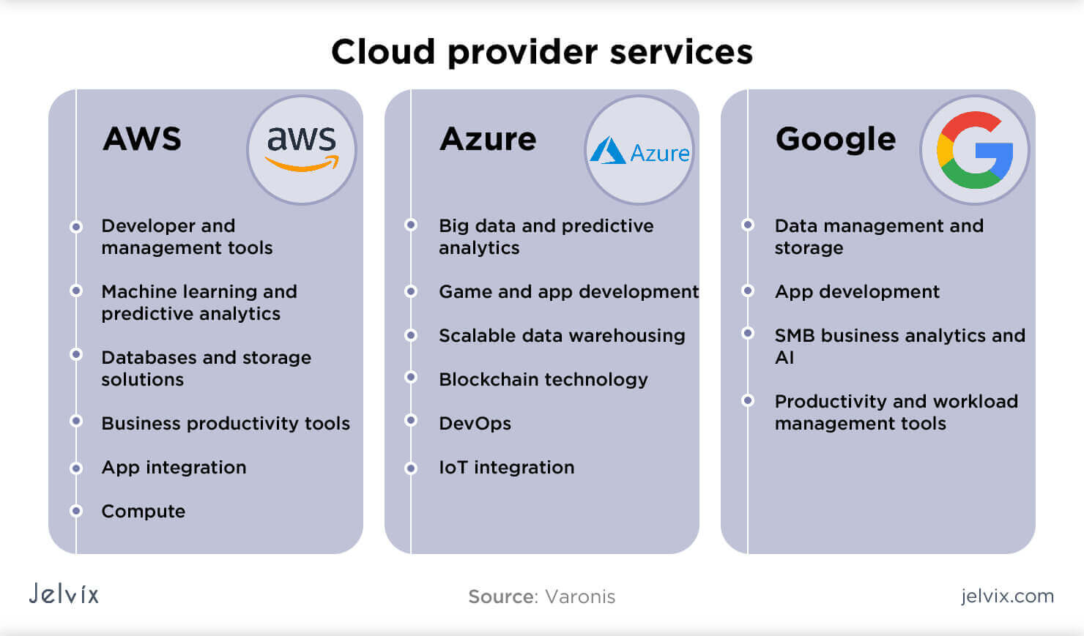
Learning 2 | Relevance for Shell
AWS EC2 offers scalable compute capacity, AWS S3 provides secure storage, and AWS VPC ensures network control and security. Together, they enhance scalability, reliability, and security in the cloud.

Slide 10
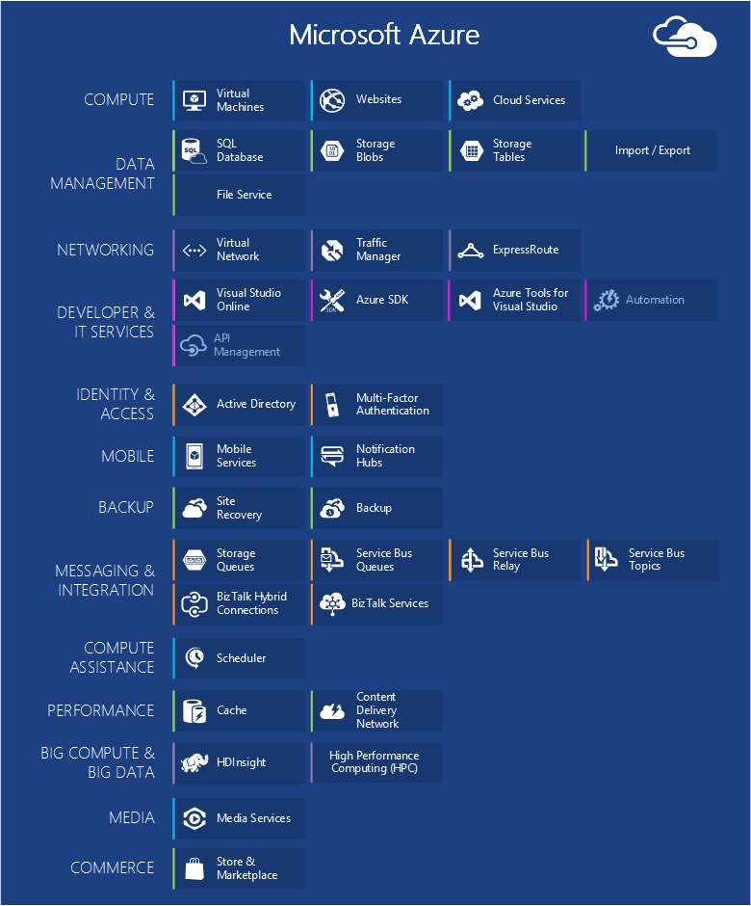
Learning 3 | Relevance for Shell
Azure Virtual Machines provide flexible compute power, Azure Virtual Network creates secure, customizable networks, and Azure Storage offers reliable data backup and analytics.
Together, these services boost an organization’s efficiency, innovation, and security in the cloud.

Slide 11

Challenges in implementing learning

Slide 12
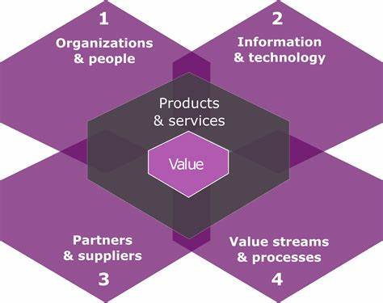
Challenge faced while implementing Learning 1
Implementing ITIL and ServiceNow can face challenges like resistance to change, skill gaps, integration complexities, and high costs. Proactive management of these issues is essential for achieving operational efficiency and improved service quality.

Slide 13
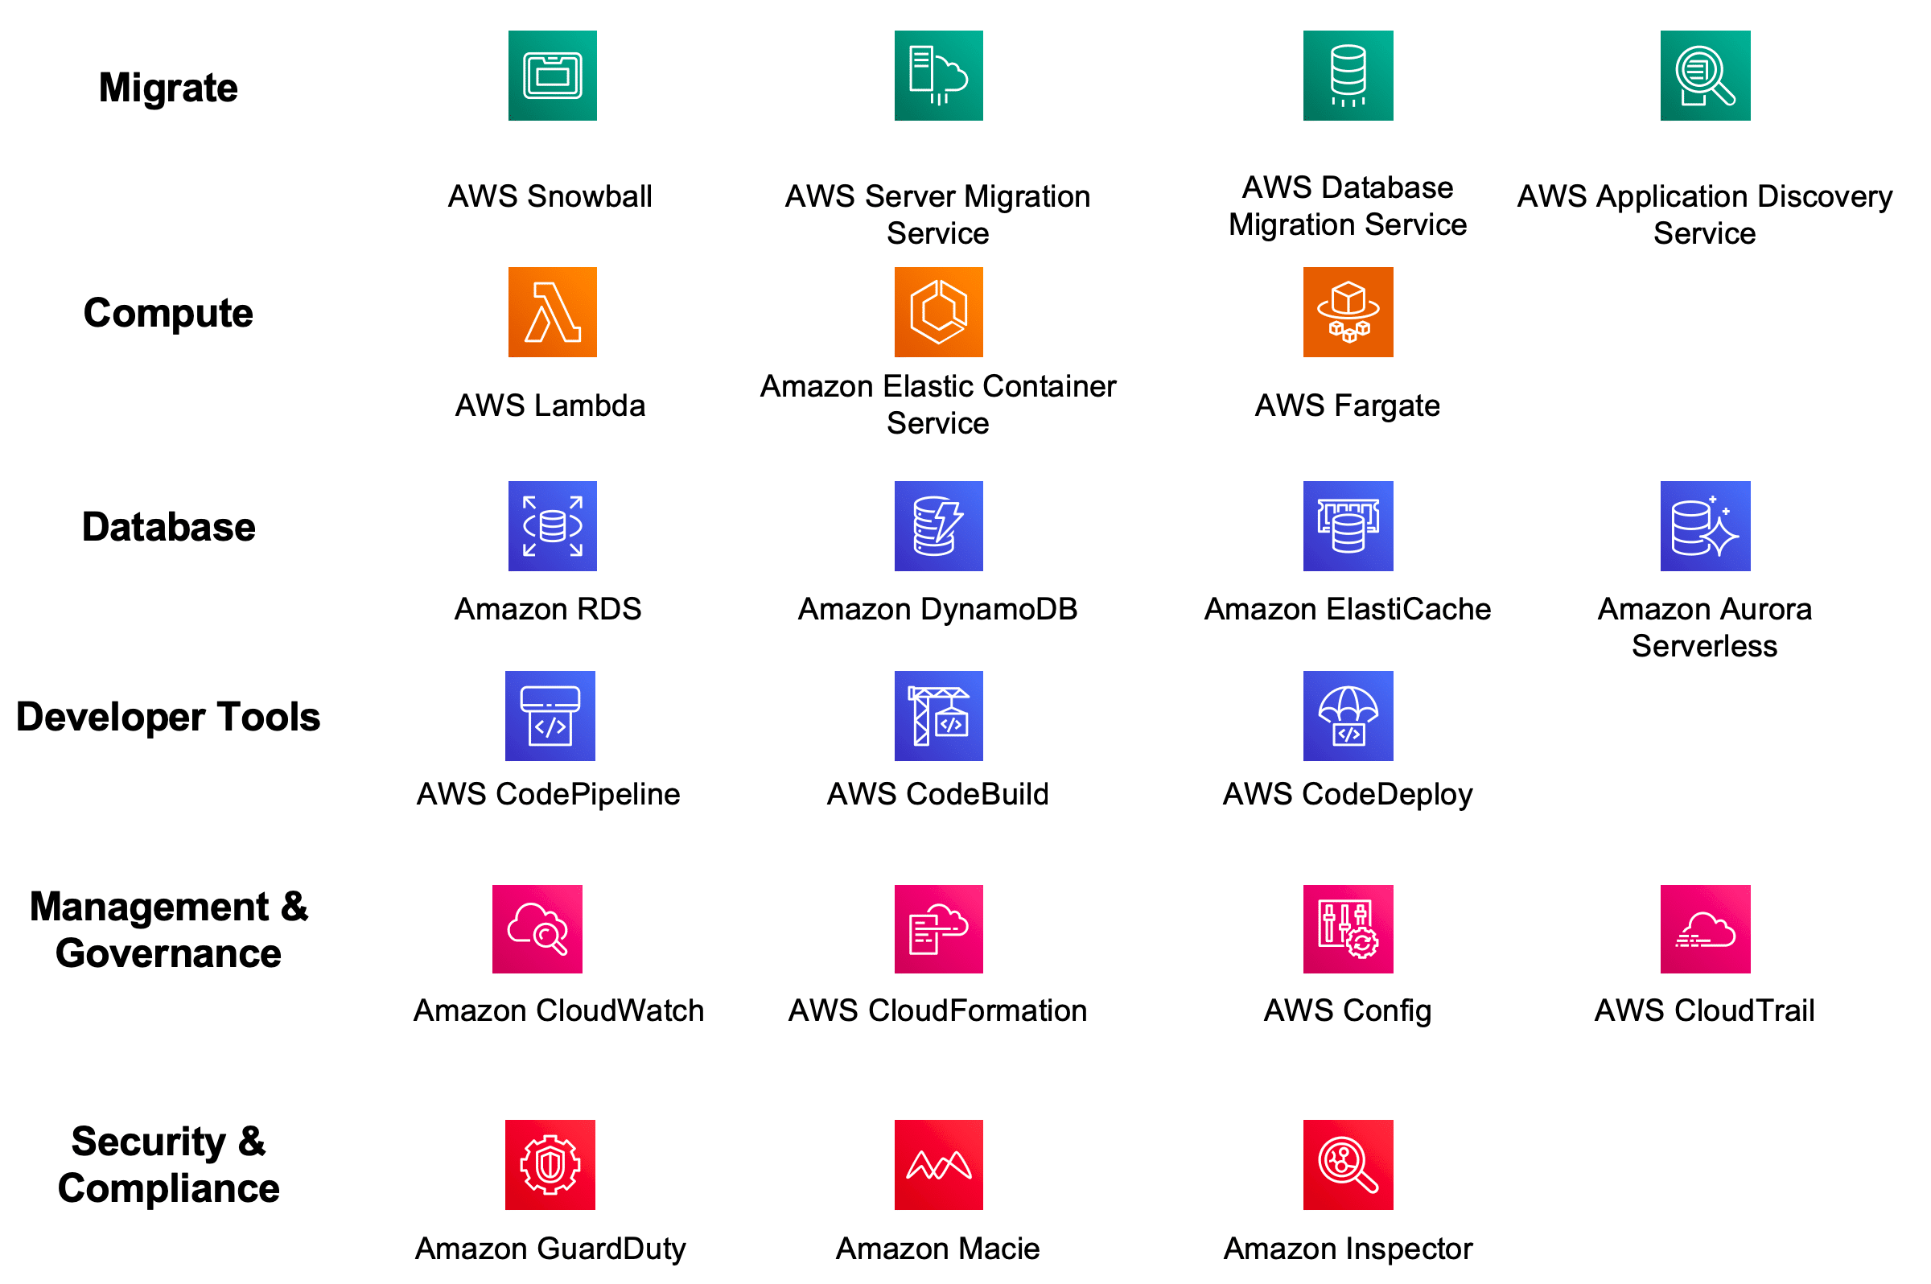
Challenge faced while implementing Learning 2
Implementing AWS EC2, S3, and VPC can be challenging due to cost management, ensuring robust security and compliance, and the complexity of integration with existing systems. Proactive management of these issues is essential to fully leverage the benefits of AWS services

Slide 14
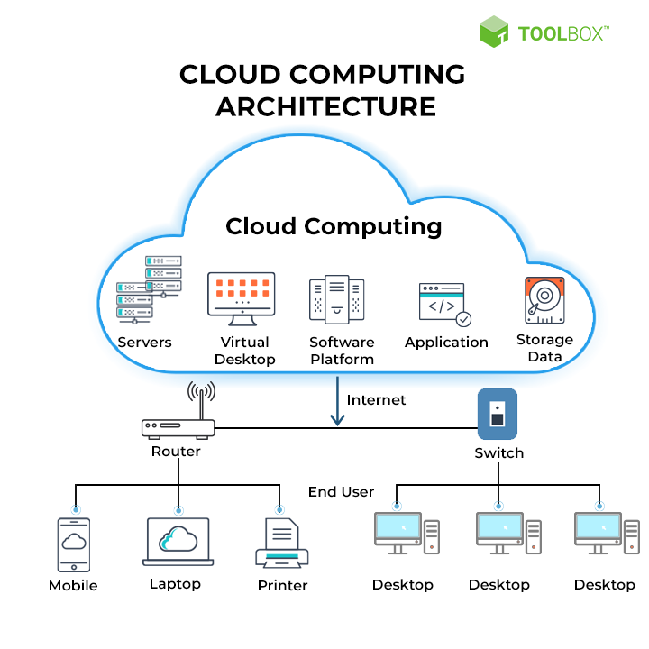
Challenge faced while implementing Learning 3
Provisioning cloud services need at most care and constant monitoring to not generate unnecessary bill. Constant practice of monitoring all the running services and stopping them when not required is a constant challenge.

Slide 15

Action Plan

Slide 16
My Action Plan for this Week
Actions
Timeline
Status
Spend some more time on AWS and Azure dashboard and get myself more familiar with their offerings.
This task need constant practice
Already started learning

Slide 17

Learning is also Fun!

Slide 18
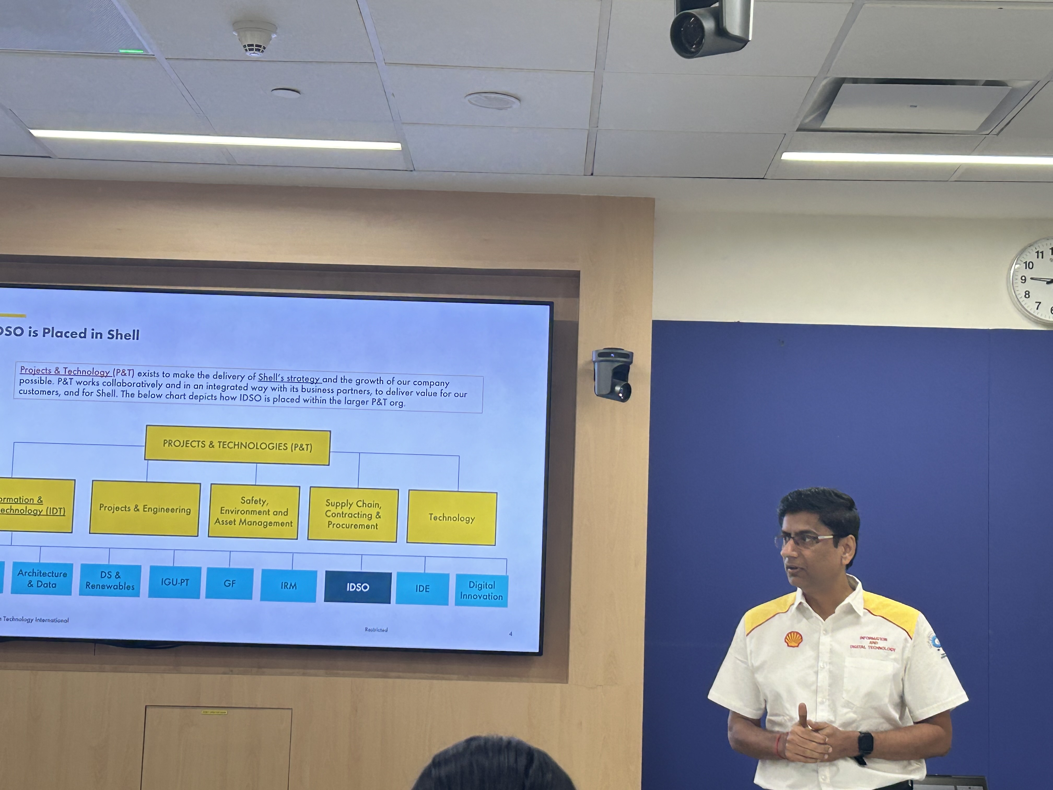
Learning is also Fun!
The frequency of hands-on is increased from the previous classes, I feel more motivated to attend the sessions now.

Slide 19

Summary
Implementing ITIL and ServiceNow helps align IT services with business goals, but challenges like resistance to change and integration complexities need proactive management.
AWS EC2, S3, and VPC enhance cloud scalability and security, though cost management and security are concerns. Similarly, Azure Virtual Machines, Virtual Network, and Storage boost efficiency and innovation, but integrating these services and managing costs can be challenging.
Continuous learning and adaptation are crucial for mastering these technologies.

Slide 20
Thank You

